Slide 1
mongoDB
FOR GIANT IDEAS

Slide 2
Agenda
JS Basics
MongoDB & Hands On
PyMongo
MapReduce

Slide 3
JavaScript & JSON Basics
MongoDB through JS shell
MapReduce
15 mins
10 mins
40 mins
20 mins
15 mins
MongoDB Introduction
PyMongo

Slide 4
JavaScript
Notes:
use db, show dbs, show collections, db.stats()
Getting help = tab twice
Check implementation of any built-in function using db.collection.save

Slide 5
JS - Datatypes
Boolean
Number
String
Null
Undefined

Slide 6
JS - Data Structures & Functions
JS | Python | Java
Array | list | ArrayList
Object | dict | Map

Slide 7
MongoDB - A database for modern web
Document data model
Indexes
Replication
Scaling

Slide 8
Database structure
Collection
Collection
Document
Document
Database
Document
Document
Document
Document

Slide 9
Mongo shell
CRUD operations
Comparison & Logical operators
More functions
Indexing
Aggregation
Help in shell

Slide 10
Comparison & Logical Operators
Comparison operators
Logical operators
$eq
$gt
$gte
$lt
$lte
$ne
$in
$nin
$and
$or
$not
$nor

Slide 11
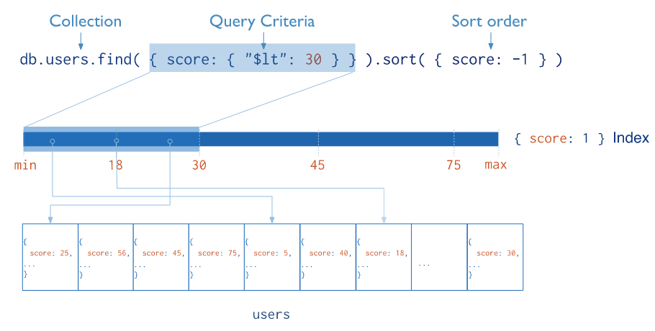
Indexing

Slide 12
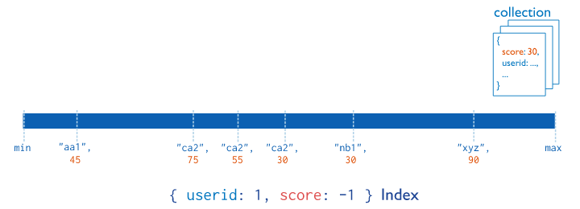
Compound Index

Slide 13
Aggregation
MongoDB provides two ways to perform aggregation :
Aggregation Pipeline
Map-Reduce Function

Slide 14
Aggregation Pipeline
$match
$group
$project
$limit
$skip
$sort

Slide 15
PyMongo
Notes:
use db, show dbs, show collections, db.stats()
Getting help = tab twice
Check implementation of any built-in function using db.collection.save

Slide 16
MapReduce
Notes:
use db, show dbs, show collections, db.stats()
Getting help = tab twice
Check implementation of any built-in function using db.collection.save

Slide 17
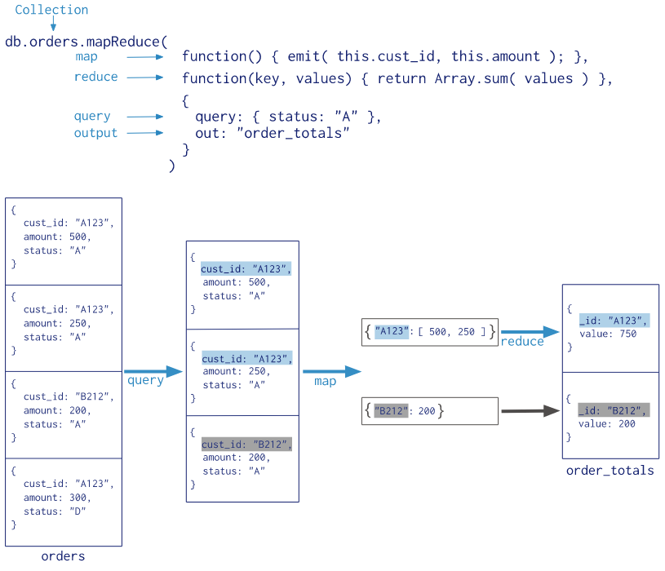
MapReduce

Slide 18
JSON
Notes:
use db, show dbs, show collections, db.stats()
Getting help = tab twice
Check implementation of any built-in function using db.collection.save

Slide 19
Thank You !
Notes:
use db, show dbs, show collections, db.stats()
Getting help = tab twice
Check implementation of any built-in function using db.collection.save

